Slide 1
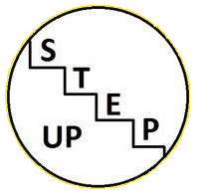
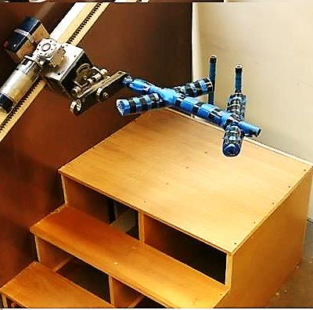
Step Up
Group 8
Paula Murphy
Tadhg Brennan
Craig Kennedy
Varun Soni
Jonathan Douglas - Smith
Moving forward one step at a time
School of Mechanical and Manufacturing Engineering
3B8 Universal Innovative Design

Slide 2
Needfinding Activities
Stakeholders:
Brainstormed as a group to come up with potential stakeholders
Approached the potential stakeholders and explained the project to them to see if they would be willing to take part.
Prepared survey questions and interviewed stakeholders.
Observed our elderly stakeholders engage in day to day activities.
Focus Group:
We emailed relevant organizations, explaining our project to them and asking them if it was possible to set up a focus group. Friends of the Elderly allowed us to do this.
Online Research:
After working with our stakeholders and focus group we started doing online research.
We looked at the problems that were mentioned in our meetings and studied several literary reviews on them.
We observed the statistics on the problems to see how common they actually were.

Slide 3
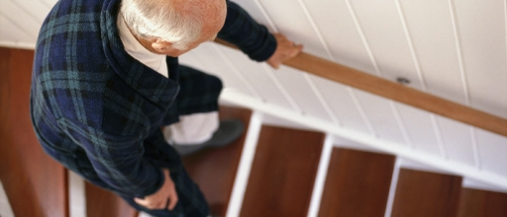
Problem Area
The main problem area identified was falling on the stairs due to:
Rushing
Improper foot placement
Falling out of rhythm
Current solutions were described as:
Bulky, slow and requiring no muscular input
or
Relied too the user’s upper body strength, whist providing little support
Mission Statement:
" to create a device to prevent an elderly person from falling on the stairs in a simple, dignified and secure manner while still promoting physical activity"

Slide 4
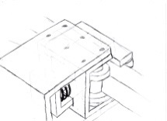
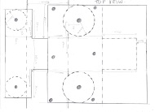
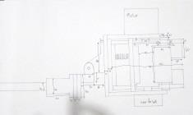
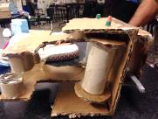
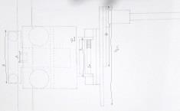
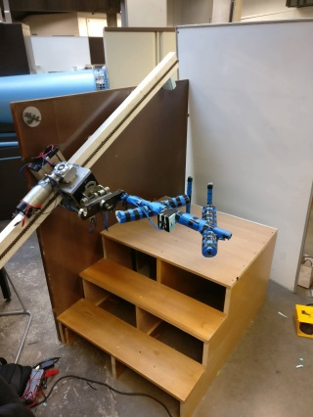
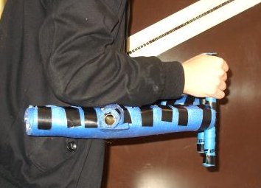
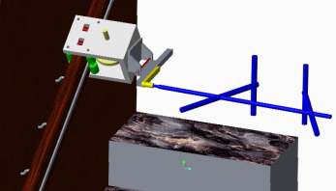
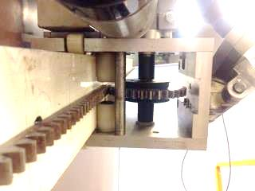
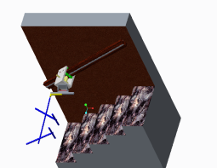
Design Process
Original Concepts
Concept development
Working Drawings
Final Product
CAD Development

Slide 5
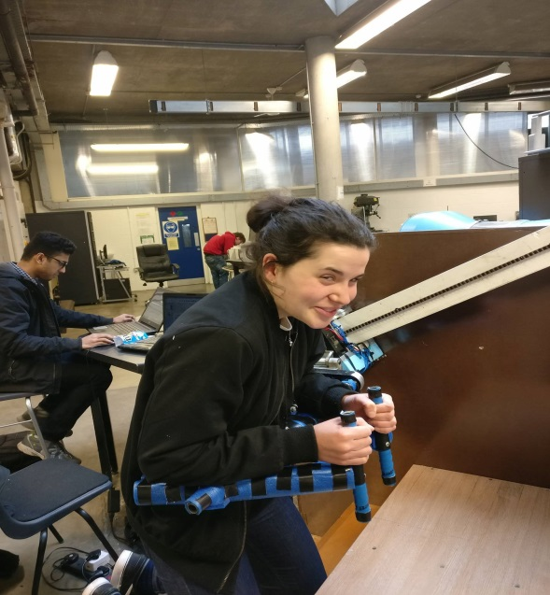
Bar Design
User can lean on entire forearm
Relives stress from user’s grip
Natural holding position
Padded for comfort and cushioning

Slide 6
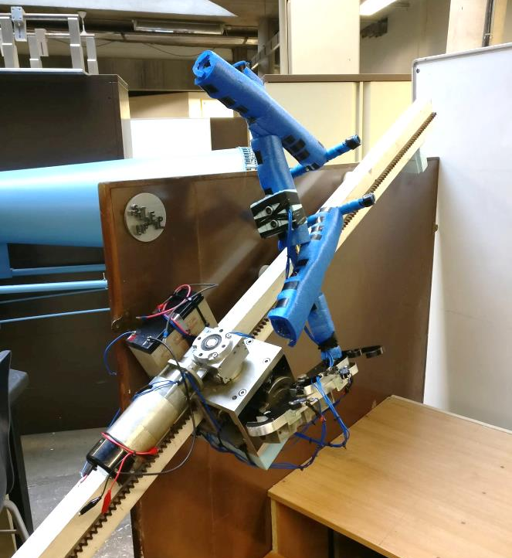
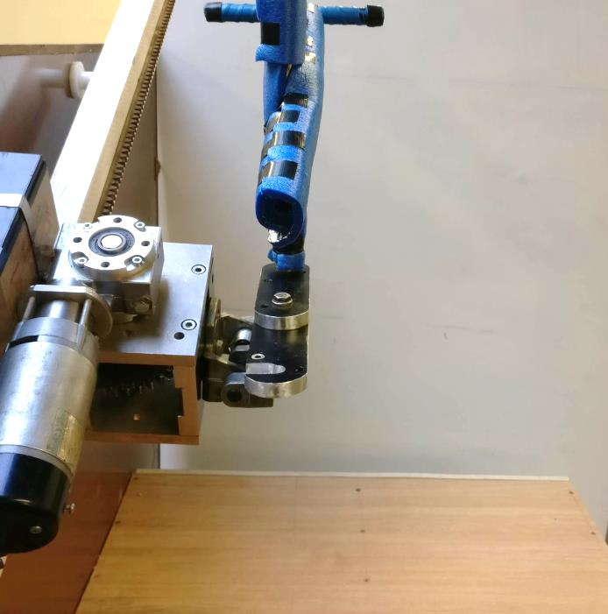
Folding Mechanism
Can be folded away when not in use
Allows easy access to and from stairs
Spring loaded for easy lifting, weightless feel

Slide 7
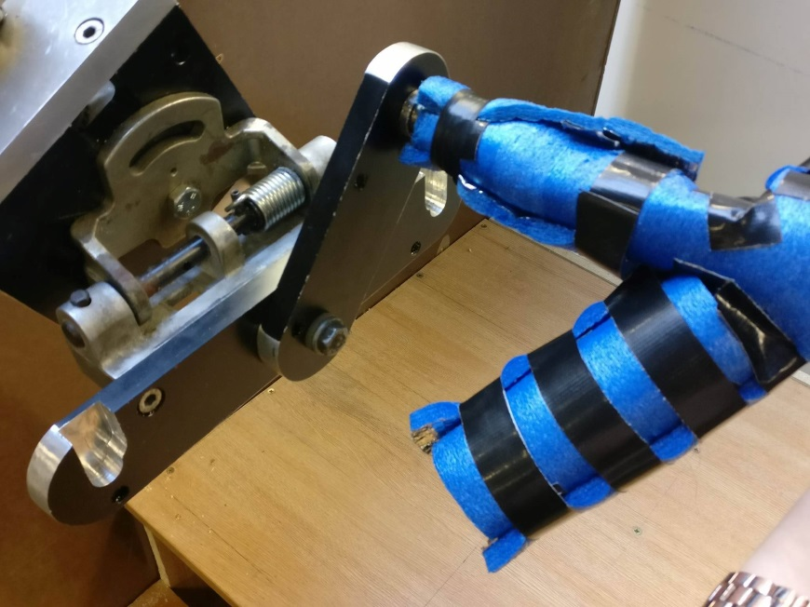
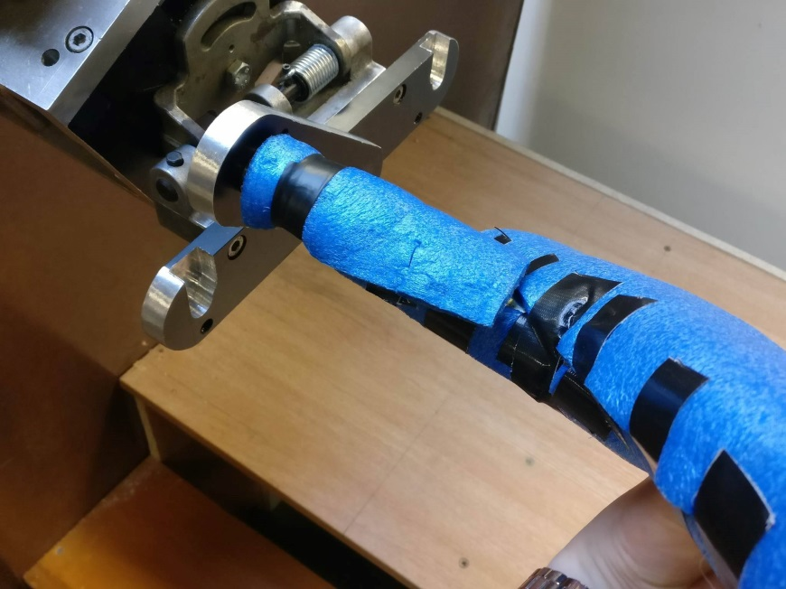
Height Adjustment
Flipping horizontally inverts bar for going up and down stairs
When flipped, the supporting bar adjusts for height by moving along the rail until it is the correct distance from the user
This avoids the user feeling ‘stooped’ when going downstairs

Slide 8
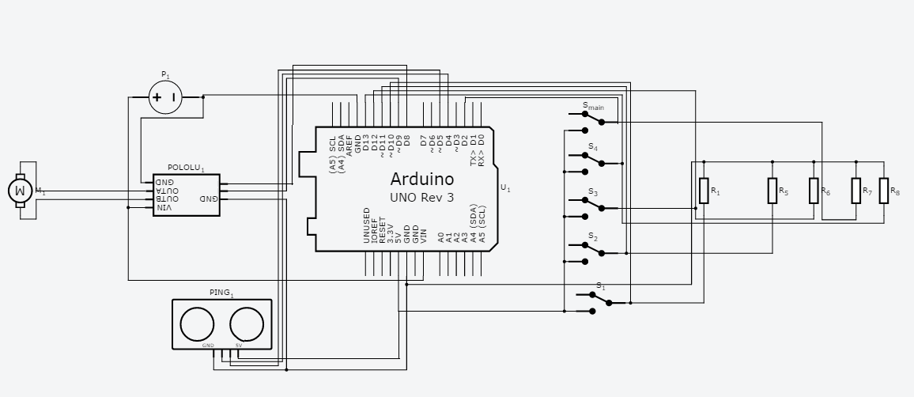
Circuit Design
Limit switches indicate when bar is at the top or bottom of the stairs or when moving upstairs or downstairs
12v motor used to drive the mechanism whose speed and direction is controlled by a motor driver
Ultrasonics detect user’s speed and matches their pace

Slide 9
Functional Video

Slide 10
Thanks for listening!
Any Questions???

